Slide 1

Direct extraction of path weak values from interferograms without auxiliary qubits
I. V. Masiello¹, A. Dvorak¹, H. Lemmel^{1,2}, and Y. Hasegawa^{1,3}
¹Atominstitut, TU Wien, Stadionallee 2, 1020 Vienna, Austria
²Institut Laue-Langevin, 71 avenue des Martyrs, 38000 Grenoble, France
³Department of Applied Physics, Hokkaido University, Kita-ku, Sapporo 060-8628, Japan

Slide 2
Contents

Slide 3
Contents
Introduction to weak values in the context of weak Von Neumann measurement

Slide 4
Contents
Introduction to weak values in the context of weak Von Neumann measurement
Weak value based description of Mach-Zehnder interferometry outside of weak measurement

Slide 5
Contents
Introduction to weak values in the context of weak Von Neumann measurement
Weak value based description of Mach-Zehnder interferometry outside of weak measurement
Experiment and results

Slide 6
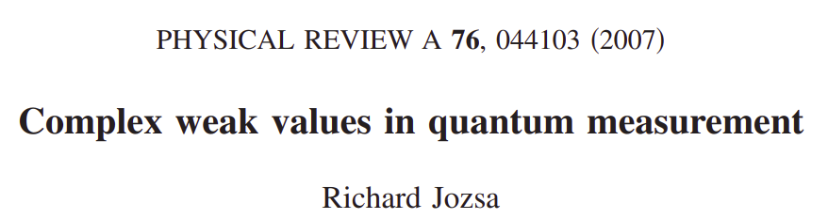
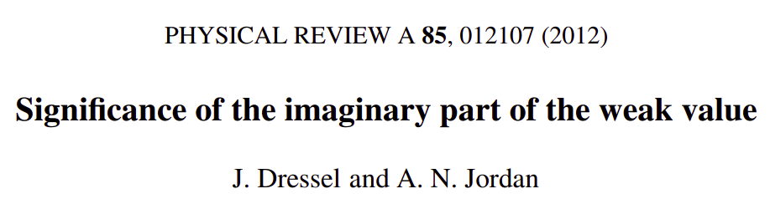
Introduction to weak values
References:

Slide 7


Introduction to weak values
Weak value:

Slide 8
Introduction to weak values
Observable:
Pre-selected state:
Post-selected State:
Weak value:

Slide 9
Introduction to weak values
Observable:
Pre-selected state:
Post-selected State:
Complex number
Weak value:

Slide 10
Introduction to weak values
Observable:
Pre-selected state:
Post-selected State:
Complex number
Not bounded by eigenvalues
Weak value:

Slide 11
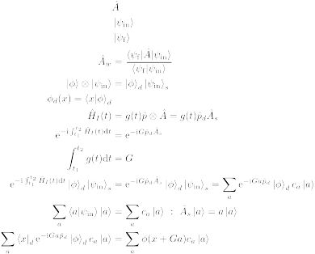
Introduction to weak values
Von Neumann measurement

Slide 12
Introduction to weak values
Von Neumann measurement
Detector
System

Slide 13
Introduction to weak values
Von Neumann measurement
Detector
System

Slide 14
Introduction to weak values
Von Neumann measurement
Interaction
Hamiltonian

Slide 15
Introduction to weak values
Von Neumann measurement
Interaction
Hamiltonian

Slide 16
Introduction to weak values
Von Neumann measurement

Slide 17
Introduction to weak values
Von Neumann measurement

Slide 18
Introduction to weak values
Von Neumann measurement

Slide 19
Introduction to weak values
Von Neumann measurement

Slide 20
Introduction to weak values
Von Neumann measurement

Slide 21
Introduction to weak values
Von Neumann measurement

Slide 22
Introduction to weak values
Von Neumann measurement

Slide 23
Introduction to weak values
Von Neumann measurement
Translation operator

Slide 24
Introduction to weak values
Von Neumann measurement
Position
projection

Slide 25
Introduction to weak values
Von Neumann measurement
Position
projection

Slide 26


Introduction to weak values
Stern-Gerlach:
Position
Spin

Slide 27

Introduction to weak values
Stern-Gerlach:
Position
Spin
N
S

Slide 28
Introduction to weak values
Stern-Gerlach:
Position
Spin
N
N
S
S

Slide 29
Introduction to weak values
Weak measurement:

Slide 30
Introduction to weak values
Weak measurement:

Slide 31
Introduction to weak values
Weak measurement:

Slide 32
Introduction to weak values
Weak measurement:

Slide 33
Introduction to weak values
Weak measurement:

Slide 34
Introduction to weak values
Weak measurement:

Slide 35
Introduction to weak values
Weak measurement:

Slide 36
Introduction to weak values
Weak measurement:

Slide 37
Introduction to weak values
Weak measurement:

Slide 38

Introduction to weak values
Weak measurement:

Slide 39
Introduction to weak values
Weak measurement:
For a real valued detector function

Slide 40

Introduction to weak values
Weak measurement:
For a real valued detector function

Slide 41
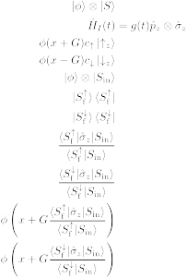
Introduction to weak values
Stern-Gerlach:

Slide 42
Introduction to weak values
Stern-Gerlach:
N
S

Slide 43
Introduction to weak values
Stern-Gerlach:
N
S

Slide 44
Introduction to weak values
Stern-Gerlach:
N
S

Slide 45
Introduction to weak values
Stern-Gerlach:
N
N
S
S

Slide 46
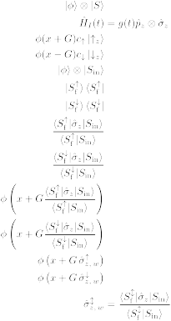
Introduction to weak values
Stern-Gerlach:
N
N
S
S

Slide 47
Introduction to weak values
Stern-Gerlach:
N
N
S
S

Slide 48

Introduction to weak values

Slide 49
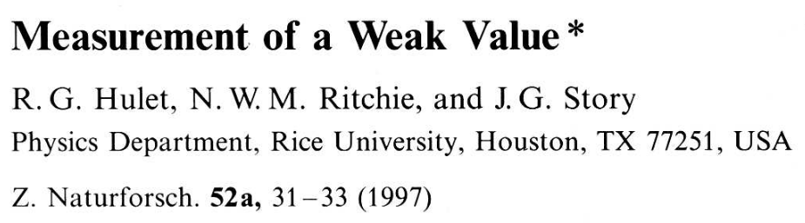
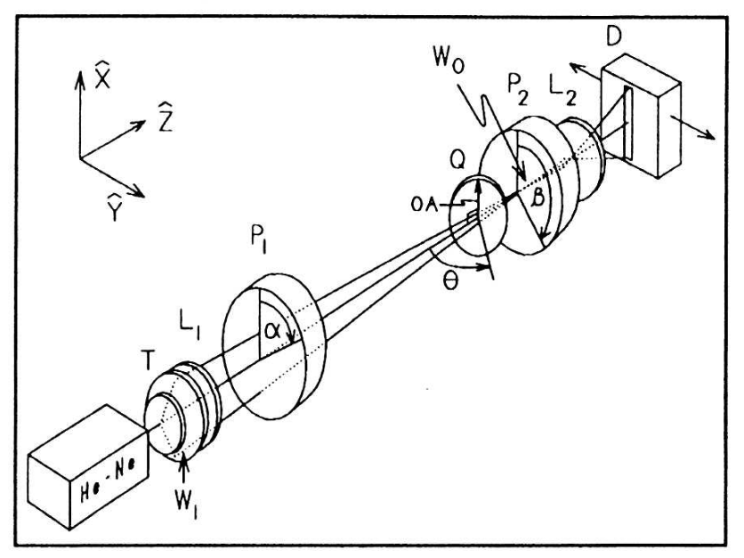
Introduction to weak values

Slide 50
WEAK VALUE
WEAK MEASUREMENT

Slide 51
Is the weak value always weak?
Weak value:

Slide 52
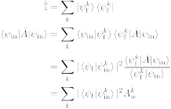
Is the weak value always weak?
Expectation value:

Slide 53
Is the weak value always weak?
Expectation value:

Slide 54
Is the weak value always weak?
Expectation value:

Slide 55
Is the weak value always weak?
Expectation value:

Slide 56
Is the weak value always weak?
Expectation value:

Slide 57
Is the weak value always weak?
Expectation value:

Slide 58
CAN WEAK VALUES DESCRIBE INTERFEROMETRY?

Slide 59



Weak values and interferometry
Standard interferometry formalism

Slide 60
Weak values and interferometry
Standard interferometry formalism

Slide 61
Weak values and interferometry
Standard interferometry formalism

Slide 62
Weak values and interferometry
Standard interferometry formalism

Slide 63
Weak values and interferometry
Standard interferometry formalism

Slide 64
Weak values and interferometry
Standard interferometry formalism

Slide 65

Weak values and interferometry
Standard interferometry formalism
Measured intensity

Slide 66
Weak values and interferometry
Weak value picture
Pre-selection

Slide 67
Weak values and interferometry
Weak value picture
Pre-selection
Interaction

Slide 68

Weak values and interferometry
Weak value picture
Pre-selection
Interaction

Slide 69
Weak values and interferometry
Weak value picture
Pre-selection
Interaction
Post-selection

Slide 70
Weak values and interferometry
Weak value picture
Measured intensity

Slide 71
Weak values and interferometry
Weak value picture
Measured intensity

Slide 72
Weak values and interferometry
Weak value picture
Measured intensity

Slide 73
Weak values and interferometry
Weak value picture
Measured intensity
Path weak value

Slide 74
Weak values and interferometry
Weak value picture
Measured intensity

Slide 75
Weak values and interferometry
Weak value picture
Measured intensity

Slide 76
Weak values and interferometry
Weak value picture
Measured intensity

Slide 77
Weak values and interferometry
Weak value picture
Measured intensity
Amplitude
square

Slide 78
Weak values and interferometry
Weak value picture
Measured intensity
Real part
Amplitude
square

Slide 79
Weak values and interferometry
Weak value picture
Measured intensity
Real part
Amplitude
square
Imaginary
part

Slide 80

Weak values and interferometry
Weak value extraction

